Slide 1
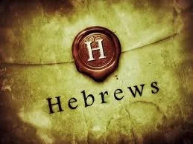
1
WEEK 3
8-23-26

Slide 2
Hebrews 1:1-4
2
1 God, after He spoke long ago to the fathers in the prophets in many portions and in many ways,
2 in these last days has spoken to us in His Son, whom He appointed heir of all things, through whom also He made the world.
3 And He is the radiance of His glory and the exact representation of His nature, and upholds all things by the word of His power. When He had made purification of sins, He sat down at the right hand of the Majesty on high,
4 having become as much better than the angels, as He has inherited a more excellent name than they.

Slide 3
Hebrews 1:1-4
3
1 God, after He spoke long ago to the fathers in the prophets in many portions and in many ways,
2 in these last days has spoken to us in His Son, whom He appointed heir of all things, through whom also He made the world.
3 And He is the radiance of His glory and the exact representation of His nature, and upholds all things by the word of His power. When He had made purification of sins, He sat down at the right hand of the Majesty on high,
4 having become as much better than the angels, as He has inherited a more excellent name than they.

Slide 4
Hebrews 1:1-4
4
1 God, after He spoke long ago to the fathers in the prophets in many portions and in many ways,
2 in these last days has spoken to us in His Son, whom He appointed heir of all things, through whom also He made the world.
3 And He is the radiance of His glory and the exact representation of His nature, and upholds all things by the word of His power. When He had made purification of sins, He sat down at the right hand of the Majesty on high,
4 having become as much better than the angels, as He has inherited a more excellent name than they.

Slide 5
Hebrews 1:5-8
5
5 For to which of the angels did He ever say, "YOU ARE MY SON, TODAY I HAVE BEGOTTEN YOU"? And again, "I WILL BE A FATHER TO HIM AND HE SHALL BE A SON TO ME"?
6 And when He again brings the firstborn into the world, He says, "AND LET ALL THE ANGELS OF GOD WORSHIP HIM."
7 And of the angels He says, "WHO MAKES HIS ANGELS WINDS, AND HIS MINISTERS A FLAME OF FIRE."
8 But of the Son [He says], "YOUR THRONE, O GOD, IS FOREVER AND EVER, AND THE RIGHTEOUS SCEPTER IS THE SCEPTER OF HIS KINGDOM.

Slide 6
Hebrews 1:5-8
6
5 For to which of the angels did He ever say, "YOU ARE MY SON, TODAY I HAVE BEGOTTEN YOU"? And again, "I WILL BE A FATHER TO HIM AND HE SHALL BE A SON TO ME"?
6 And when He again brings the firstborn into the world, He says, "AND LET ALL THE ANGELS OF GOD WORSHIP HIM."
7 And of the angels He says, "WHO MAKES HIS ANGELS WINDS, AND HIS MINISTERS A FLAME OF FIRE."
8 But of the Son [He says], "YOUR THRONE, O GOD, IS FOREVER AND EVER, AND THE RIGHTEOUS SCEPTER IS THE SCEPTER OF HIS KINGDOM.
The author is telling you that Christ is not an angel elevated to “Son”. Christ was already higher than an angel, or a king.
Psalm 2:7: "You are my Son; today I have begotten you," which originally spoke of the king's rule, but is applied in the New Testament to the Messiah.
John 1:14And the Word became flesh, and dwelt among us, and we saw His glory, glory as of the only begotten from the Father, full of grace and truth.

Slide 7
Hebrews 1:5-8
7
5 For to which of the angels did He ever say, "YOU ARE MY SON, TODAY I HAVE BEGOTTEN YOU"? And again, "I WILL BE A FATHER TO HIM AND HE SHALL BE A SON TO ME"?
6 And when He again brings the firstborn into the world, He says, "AND LET ALL THE ANGELS OF GOD WORSHIP HIM."
7 And of the angels He says, "WHO MAKES HIS ANGELS WINDS, AND HIS MINISTERS A FLAME OF FIRE."
8 But of the Son [He says], "YOUR THRONE, O GOD, IS FOREVER AND EVER, AND THE RIGHTEOUS SCEPTER IS THE SCEPTER OF HIS KINGDOM.
The Greek word monogenēs (μονογενής) means "one of a kind," "unique," or "only." While traditionally translated as "only begotten," modern studies and lexicons show it emphasizes a special, one-of-a-kind relationship or status rather than a physical act of birth or procreation.
The early Latin manuscripts rendered monogenēs in the Christological passages as unicus (“unique“), but in Jerome’s Latin version it was changed to “only begotten” (unigenitus).

Slide 8
Hebrews 1:5-8
8
5 For to which of the angels did He ever say, "YOU ARE MY SON, TODAY I HAVE BEGOTTEN YOU"? And again, "I WILL BE A FATHER TO HIM AND HE SHALL BE A SON TO ME"?
6 And when He again brings the firstborn into the world, He says, "AND LET ALL THE ANGELS OF GOD WORSHIP HIM."
7 And of the angels He says, "WHO MAKES HIS ANGELS WINDS, AND HIS MINISTERS A FLAME OF FIRE."
8 But of the Son [He says], "YOUR THRONE, O GOD, IS FOREVER AND EVER, AND THE RIGHTEOUS SCEPTER IS THE SCEPTER OF HIS KINGDOM.

Slide 9
Hebrews 1:5 & John 3:16
9
1:5 For to which of the angels did He ever say, "YOU ARE MY SON, TODAY I HAVE BEGOTTEN YOU"? And again, "I WILL BE A FATHER TO HIM AND HE SHALL BE A SON TO ME"? (1995 NASB)
1:5 For to which of the angels did He ever say,
“You are My Son,
Today I have fathered You”? (2010 NASB)
3:16 For God so loved the world, that He gave His only begotten Son, that whoever believes in Him shall not perish, but have eternal life. (NASB)
3:16 For God so loved the world that he gave his one and only Son, that whoever believes in him shall not perish but have eternal life. (NIV)

Slide 10
Hebrews 1:5 & John 3:16
10
1:5 For to which of the angels did He ever say, "YOU ARE MY SON, TODAY I HAVE BEGOTTEN YOU"? And again, "I WILL BE A FATHER TO HIM AND HE SHALL BE A SON TO ME"? (1995 NASB)
1:5 For to which of the angels did He ever say,
“You are My Son,
Today I have fathered You”? (2010 NASB)
3:16 For God so loved the world, that He gave His only begotten Son, that whoever believes in Him shall not perish, but have eternal life. (NASB)
3:16 For God so loved the world that he gave his one and only Son, that whoever believes in him shall not perish but have eternal life. (NIV)
gennaō (γεννάω)
The verb meaning to beget or father a child. It denotes the actual act of bringing offspring into existence or sharing a direct biological/nature origin.
Monogenēs (μονογενής)
Unique / One of a Kind: Being the sole example of its category, without implied birth or origin.

Slide 11
Hebrews 1:5-8
11
5 For to which of the angels did He ever say, "YOU ARE MY SON, TODAY I HAVE BEGOTTEN YOU"? And again, "I WILL BE A FATHER TO HIM AND HE SHALL BE A SON TO ME"?
6 And when He again brings the firstborn into the world, He says, "AND LET ALL THE ANGELS OF GOD WORSHIP HIM.“(Deuteronomy 32:43 and Psalm 97:7)
7 And of the angels He says, "WHO MAKES HIS ANGELS WINDS, AND HIS MINISTERS A FLAME OF FIRE.“ (Psalm 104:4)
8 But of the Son [He says], "YOUR THRONE, O GOD, IS FOREVER AND EVER, AND THE RIGHTEOUS SCEPTER IS THE SCEPTER OF HIS KINGDOM. (Psalm 45:6)

Slide 12
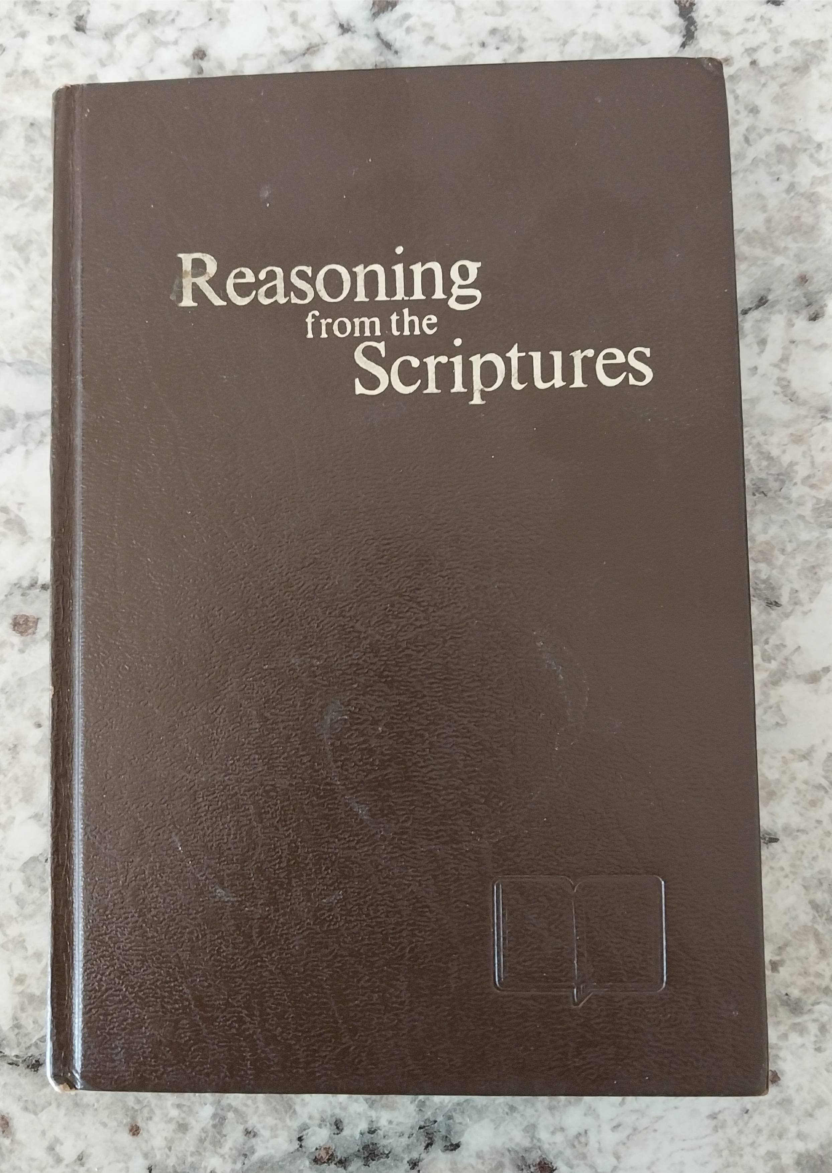
Hebrews 1:5-8
12
5 For to which of the angels did He ever say, "YOU ARE MY SON, TODAY I HAVE BEGOTTEN YOU"? And again, "I WILL BE A FATHER TO HIM AND HE SHALL BE A SON TO ME"?
6 And when He again brings the firstborn into the world, He says, "AND LET ALL THE ANGELS OF GOD WORSHIP HIM.“(Deuteronomy 32:43 and Psalm 97:7)
7 And of the angels He says, "WHO MAKES HIS ANGELS WINDS, AND HIS MINISTERS A FLAME OF FIRE.“ (Psalm 104:4)
8 But of the Son [He says], "YOUR THRONE, O GOD, IS FOREVER AND EVER, AND THE RIGHTEOUS SCEPTER IS THE SCEPTER OF HIS KINGDOM. (Psalm 45:6)

Slide 13
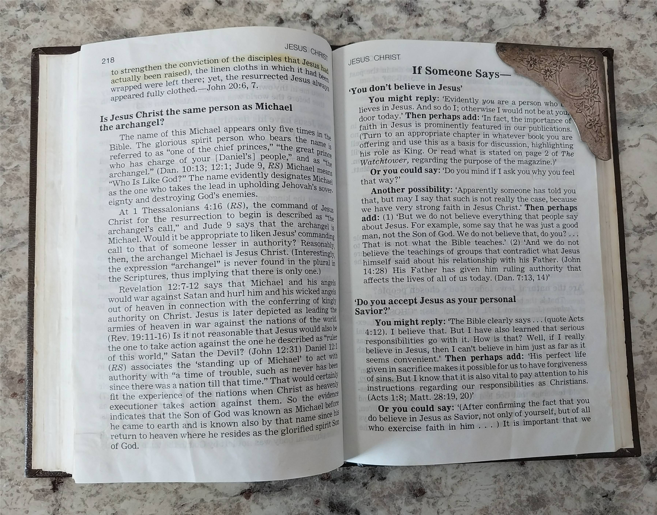
Hebrews 1:5-8
13
5 For to which of the angels did He ever say, "YOU ARE MY SON, TODAY I HAVE BEGOTTEN YOU"? And again, "I WILL BE A FATHER TO HIM AND HE SHALL BE A SON TO ME"?
6 And when He again brings the firstborn into the world, He says, "AND LET ALL THE ANGELS OF GOD WORSHIP HIM.“(Deuteronomy 32:43 and Psalm 97:7)
7 And of the angels He says, "WHO MAKES HIS ANGELS WINDS, AND HIS MINISTERS A FLAME OF FIRE.“ (Psalm 104:4)
8 But of the Son [He says], "YOUR THRONE, O GOD, IS FOREVER AND EVER, AND THE RIGHTEOUS SCEPTER IS THE SCEPTER OF HIS KINGDOM. (Psalm 45:6)

Slide 14
Hebrews 1:5-8
14
5 For to which of the angels did He ever say, "YOU ARE MY SON, TODAY I HAVE BEGOTTEN YOU"? And again, "I WILL BE A FATHER TO HIM AND HE SHALL BE A SON TO ME"?
6 And when He again brings the firstborn into the world, He says, "AND LET ALL THE ANGELS OF GOD WORSHIP HIM.“(Deuteronomy 32:43 and Psalm 97:7)
7 And of the angels He says, "WHO MAKES HIS ANGELS WINDS, AND HIS MINISTERS A FLAME OF FIRE.“ (Psalm 104:4)
8 But of the Son [He says], "YOUR THRONE, O GOD, IS FOREVER AND EVER, AND THE RIGHTEOUS SCEPTER IS THE SCEPTER OF HIS KINGDOM. (Psalm 45:6)

Slide 15
Hebrews 1:9-12
15
9 "YOU HAVE LOVED RIGHTEOUSNESS AND HATED LAWLESSNESS; THEREFORE GOD, YOUR GOD, HAS ANOINTED YOU WITH THE OIL OF GLADNESS ABOVE YOUR COMPANIONS.“ (Psalm 45:7)
10 And, "YOU, LORD, IN THE BEGINNING LAID THE FOUNDATION OF THE EARTH, AND THE HEAVENS ARE THE WORKS OF YOUR HANDS; (Psalm 102:25)
11 THEY WILL PERISH, BUT YOU REMAIN; AND THEY ALL WILL BECOME OLD LIKE A GARMENT, (Psalm 102:26)
12 AND LIKE A MANTLE YOU WILL ROLL THEM UP; LIKE A GARMENT THEY WILL ALSO BE CHANGED. BUT YOU ARE THE SAME, AND YOUR YEARS WILL NOT COME TO AN END.“ (Psalm 102:27)

Slide 16
Hebrews 1:13-14
16
13 But to which of the angels has He ever said, "SIT AT MY RIGHT HAND, UNTIL I MAKE YOUR ENEMIES A FOOTSTOOL FOR YOUR FEET"? (Psalm 110:1)
14 Are they not all ministering spirits, sent out to render service for the sake of those who will inherit salvation?

Slide 17
Hebrews 2:1-3
17
1 For this reason we must pay much closer attention to what we have heard, so that we do not drift away from it.
2 For if the word spoken through angels proved unalterable, and every violation and act of disobedience received a just punishment,
3 how will we escape if we neglect so great a salvation?
This is telling us what?

Slide 18
Hebrews 2:1-3
18
1 For this reason we must pay much closer attention to what we have heard, so that we do not drift away from it.
2 For if the word spoken through angels proved unalterable, and every violation and act of disobedience received a just punishment,
3 how will we escape if we neglect so great a salvation?
This is telling us what?

Slide 19
Angels as mediators
19
Acts 7:38 This is the one who was in the assembly in the wilderness together with the angel who spoke to him at length on Mount Sinai, and who was with our fathers; and he received living words to pass on to you
Acts 7:53 you who received the Law as ordained by angels, and yet did not keep it.
Galatians 3:19 Why the Law then? It was added on account of the violations, having been ordered through angels at the hand of a mediator, until the Seed would come to whom the promise had been made.

Slide 20
Jewish traditions
20
The Talmud (Shabbos 88b) relates that when Moses ascended Mount Sinai to receive the Torah, the angels challenged him saying, “What is this mortal doing amongst us?” Moses replied, “I have come to take the Torah to the Jewish people.” Whereupon the angels, addressing G‑d, petitioned, "leave the Torah with us and we will honor and cherish it.” G‑d turns to Moses and says “go ahead, answer them” and Moses responds, "My dear angels, just take a look at what the Torah commands – 'I am the Lord your G‑d who has taken you out of the land of Egypt,' 'Honor your parents.' Do you have a father and mother? Have you been enslaved in Egypt? Have you a selfish and evil inclination?” clearly demonstrating that the Torah was intended for souls vested in physical bodies confronted with the realities of our material world.

Slide 21
Jubilees 2:1
21
In the Book of Jubilees, Moses receives the contents of the entire text—covering primeval history, sacred time, and the division of the law—dictated by the Angel of the Presence
And the angel of the presence spake to Moses according to the word of the Lord, saying: Write the complete history of the creation, how in six days the Lord God finished all His works and all that He created, and kept Sabbath on the seventh day and hallowed it for all ages, and appointed it as a sign for all His works.

Slide 22
Jubilees 2:2
22
For on the first day He created the heavens which are above and the earth and the waters and all the spirits which serve before him -the angels of the presence, and the angels of sanctification, and the angels [of the spirit of fire and the angels] of the spirit of the winds, and the angels of the spirit of the clouds, and of darkness, and of snow and of hail and of hoar frost, and the angels of the voices and of the thunder and of the lightning, and the angels of the spirits of cold and of heat, and of winter and of spring and of autumn and of summer and of all the spirits of his creatures which are in the heavens and on the earth, (He created) the abysses and the darkness, eventide <and night>, and the light, dawn and day, which He hath prepared in the knowledge of his heart

Slide 23
Jubilees 2:2
23
For on the first day He created the heavens which are above and the earth and the waters and all the spirits which serve before him -the angels of the presence, and the angels of sanctification, and the angels [of the spirit of fire and the angels] of the spirit of the winds, and the angels of the spirit of the clouds, and of darkness, and of snow and of hail and of hoar frost, and the angels of the voices and of the thunder and of the lightning, and the angels of the spirits of cold and of heat, and of winter and of spring and of autumn and of summer and of all the spirits of his creatures which are in the heavens and on the earth, (He created) the abysses and the darkness, eventide <and night>, and the light, dawn and day, which He hath prepared in the knowledge of his heart
This is called
“Dual Mediators”

Slide 24
Hebrews 1:1-2
24
1 God, after He spoke long ago to the fathers in the prophets in many portions and in many ways,
2 in these last days has spoken to us in His Son, whom He appointed heir of all things, through whom also He made the world.

Slide 25
Hebrews 1:1-2
25
1 God, after He spoke long ago to the fathers in the prophets in many portions and in many ways,
2 in these last days has spoken to us in His Son, whom He appointed heir of all things, through whom also He made the world.
1 Timothy 2:5 For there is one God, and one mediator also between God and mankind, the Man Christ Jesus.

