Slide 1
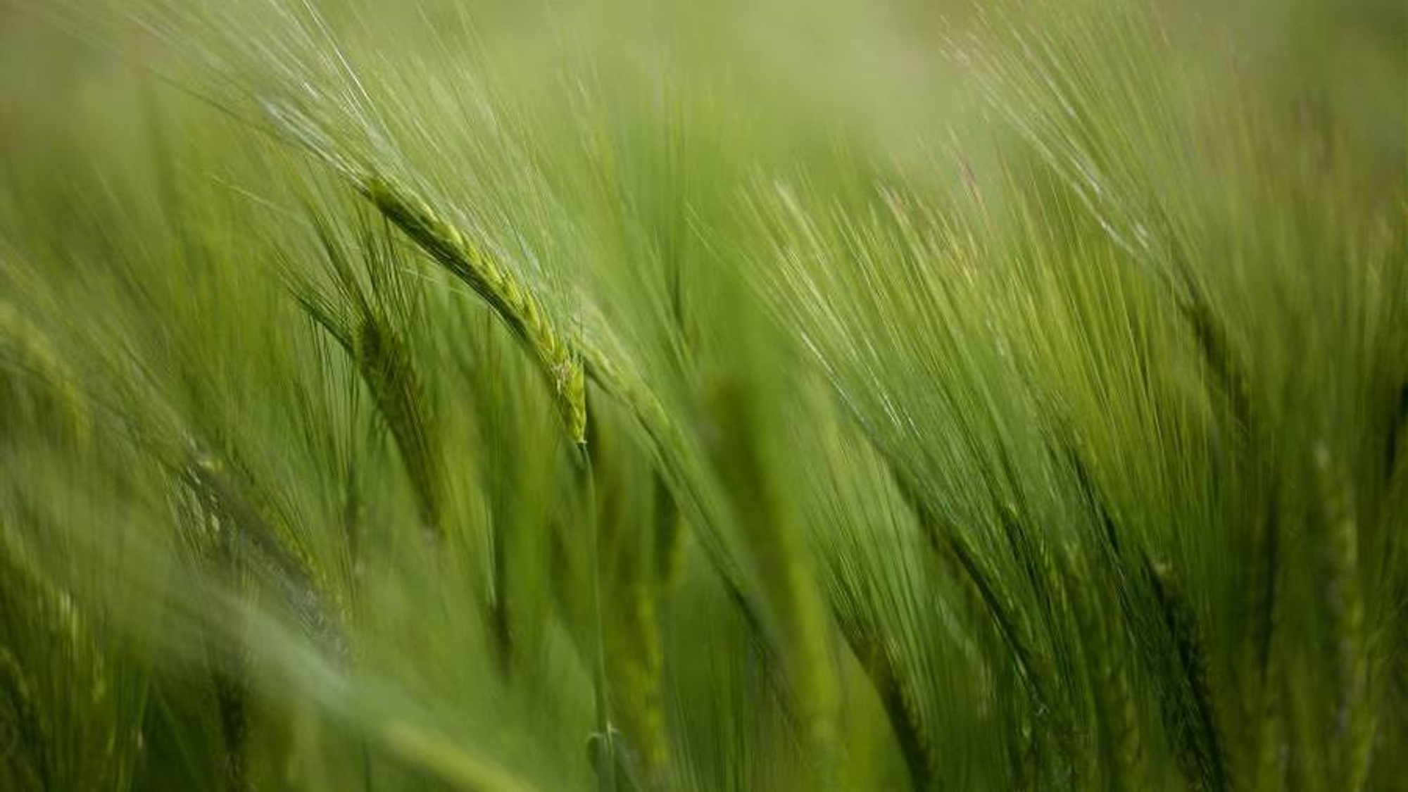
EPHESIANS 5:1-2 (ESV)
1 Therefore be imitators of God, as beloved children. 2 And walk in love, as Christ loved us and gave himself up for us, a fragrant offering and sacrifice to God.

Slide 2
EPHESIANS 5:19-21 (ESV)
19 …making melody to the Lord with your heart, 20 Giving thanks always and for everything to God the Father in the name of our Lord Jesus Christ, 21 Submitting to one another out of reverence for Christ.

Slide 3
WHAT DOES IT MEAN TO IMITATE?

Slide 4
WHO DO YOU TEND TO IMITATE? HOW SO?

Slide 5
In what specific way is god asking you to imitate him?

Slide 6

IMAGO DEI:
MADE IN THE IMAGE OF GOD
WHAT ARE THE POTENTIAL RAMIFICATIONS?

Slide 7
THE CHALLENGE:
LIVING IN THE IMAGE OF GOD
EPHESIANS 5:21 (ESV)
Submitting to one another
out of reverence for Christ.

Slide 8
WHAT DON’T YOU LIKE ABOUT SUBMISSION?
H

Slide 9
WHAT DOES THE LORD JESUS TEACH US ABOUT SUBMISSION?
H

Slide 10
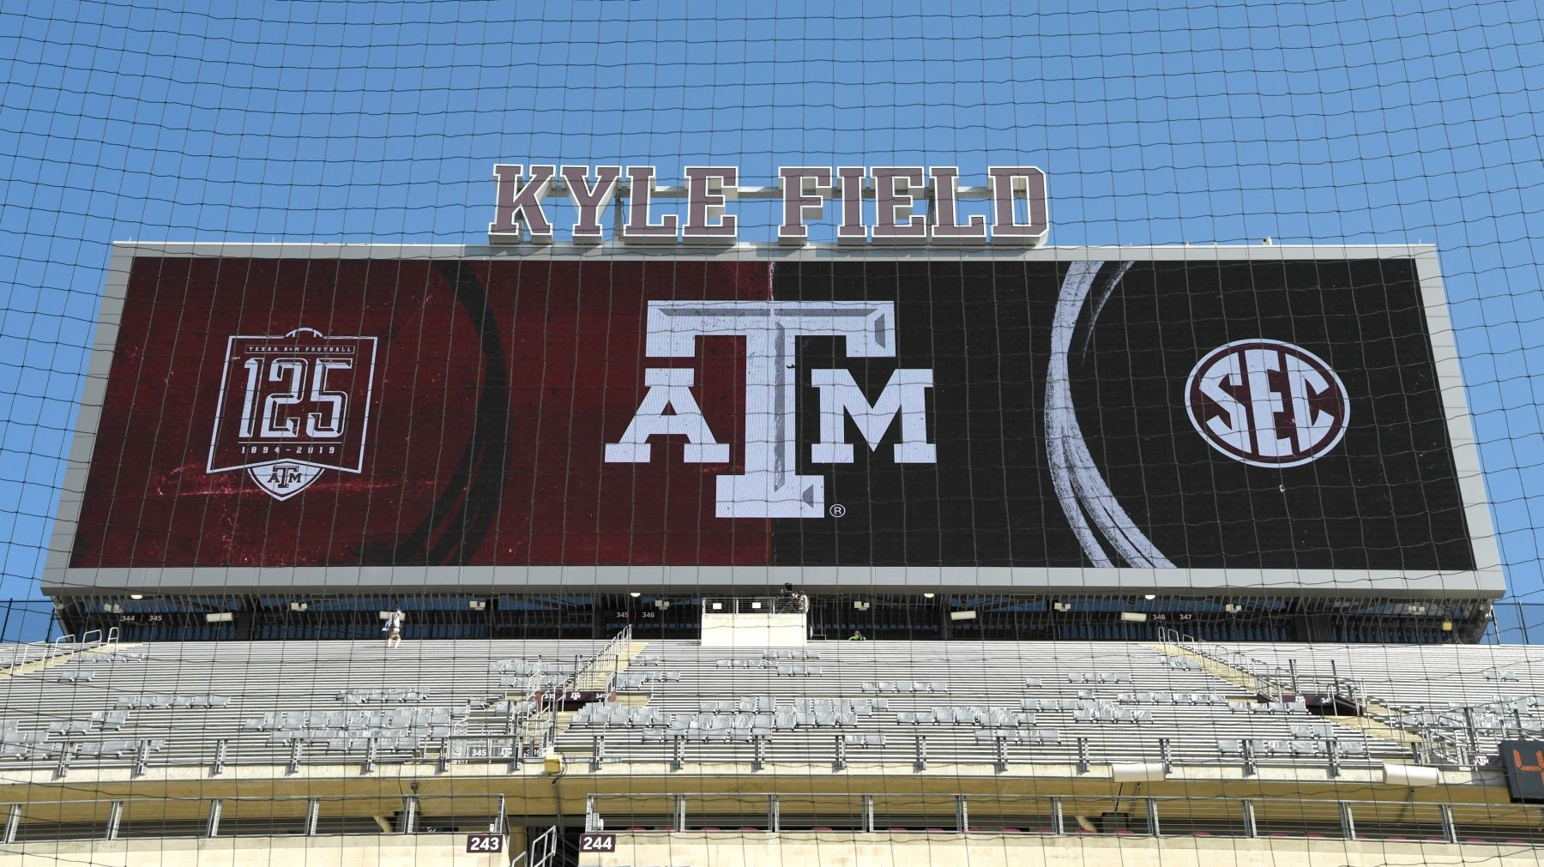
SUBMISSION
WOMEN
3 3
MEN
9

Slide 11
IN LIGHT OF MOSES' WORDS IN DEUTERONOMY 6:5?
Love the LORD your God with all your heart and with all your soul and with all your strength.
Ephesians 5:22-24 (ESV)
²² Wives, submit to your own husbands, as to the Lord. ²³ For the husband is the head of the wife even as Christ is the head of the church, his body, and is himself its Savior.²⁴ Now as the church submits to Christ, so also wives should submit in everything to their husbands.

Slide 12
IN LIGHT OF MOSES’ WORDS IN LEVITICUS 9:6-7?
⁶ And Moses said, “This is the thing that the Lord commanded you to do, that the glory of the Lord may appear to you.” ⁷ Then Moses said to Aaron, “Draw near to the altar and offer your sin offering and your burnt offering and make atonement for yourself and for the people, and bring the offering of the people and make atonement for them, as the Lord has commanded.”
Ephesians 5:25-27 (ESV)
²⁵ Husbands, love your wives, as Christ loved the church and gave himself up for her, ²⁶ that he might sanctify her, having cleansed her by the washing of water with the word, ²⁷ so that he might present the church to himself in splendor, without spot or wrinkle or any such thing, that she might be holy and without blemish.

Slide 13
IN LIGHT OF BOAZ & RUTH’S STORY?
Ephesians 5:28-33 (ESV)
²⁸ In the same way husbands should love their wives as their own bodies. He who loves his wife loves himself. ²⁹ For no one ever hated his own flesh, but nourishes and cherishes it, just as Christ does the church, ³⁰ because we are members of his body. ³¹ “Therefore a man shall leave his father and mother and hold fast to his wife, and the two shall become one flesh.” ³² This mystery is profound, and I am saying that it refers to Christ and the church. ³³ However, let each one of you love his wife as himself, and let the wife see that she respects her husband.
Kindness and Protection | Ruth 2:8-9 | Boaz ensures Ruth's safety and provides for her needs.
Acknowledgment of Virtue | Ruth 3:10 | Boaz recognizes Ruth's loyalty and character.
Marriage and Redemption | Ruth 4:13 | Boaz marries Ruth, fulfilling his role as her kinsman-redeemer.
Community Recognition | Ruth 4:14-15 | The townspeople celebrate the blessing of their union and its significance.

Slide 14
HOW DO YOU VIEW SUBMISSION NOW?

Slide 15
WHO IS GOD ASKING YOU TO SUBMIT TO RIGHT NOW?

Slide 16
HOW COULD THAT SUBMISSION
CHANGE YOUR LIFE
FOR THE BETTER?

