Slide 1

1
WEEK 6
6-7-26

Slide 2
Ephesians 3:11-14
18
11 This was in accordance with the [g]eternal purpose which He carried out in Christ Jesus our Lord,
12 in whom we have boldness and confident access through faith in Him.
13 Therefore I ask you not to become discouraged about my tribulations in your behalf, since they are your glory.
14 For this reason I bend my knees before the Father,

Slide 3
Ephesians 3:14-15
18
14 For this reason I bend my knees before the Father,
15 from whom [m]every family in heaven and on earth derives its name,

Slide 4
Ephesians 3:16-19
18
16 that He would grant you, according to the riches of His glory, to be strengthened with power through His Spirit in the inner man,
17 so that Christ may dwell in your hearts through faith; [and] that you, being rooted and grounded in love,
18 may be able to comprehend with all the saints what is the breadth and length and height and depth,
19 and to know the love of Christ which surpasses knowledge, that you may be filled up to all the fullness of God.

Slide 5
Ephesians 3:20-21
19
20 Now to Him who is able to do far more abundantly beyond all that we ask or think, according to the power that works within us,
21to Him [be] the glory in the church and in Christ Jesus to all generations forever and ever. Amen.

Slide 6
Cousin Leon
19
Leon was a coach and school teacher about for 30 years.

Slide 7
Cousin Leon
19
Leon was a coach and school teacher about for 30 years.
“When your team is winning everyone says, ‘What a great bunch of boys you have this year coach!’
When you are losing, everyone says, ‘It’s the coaches fault.”

Slide 8
Cousin Leon
19
Leon was a coach and school teacher about for 30 years.
“When your team is winning everyone says, ‘What a great bunch of boys you have this year coach!’
When you are losing, everyone says, ‘It’s the coaches fault.”
"Deep within you is everything that is perfect, ready to radiate through you and out into the world."

Slide 9
Cousin Leon
19
“When your team is winning everyone says, ‘What a great bunch of boys you have this year coach!’
When you are losing, everyone says, ‘It’s the coaches fault.”

Slide 10
Cousin Leon
19
We do that spiritually.
If someone disagrees with us theologically and they appear to us as not a “serious” Christian, it’s because their theology led them to that.

Slide 11
Cousin Leon
19
We do that spiritually.
If someone disagrees with us theologically and they appear to us as not a “serious” Christian, it’s because their theology led them to that.
If someone agrees with us but appear not as “serious”, well, “They know the truth, they only willing to give it lip service”

Slide 12
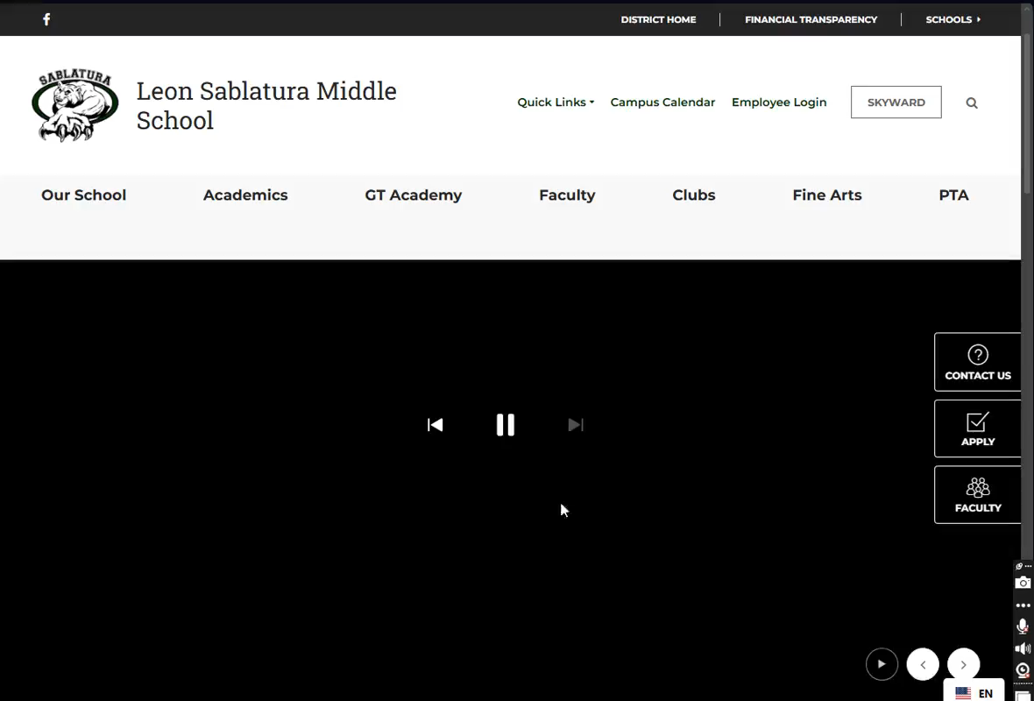
Cousin Leon sablatura
19

Slide 13
Leon sablatura Middle school Pearland Texas
19
“When your team is winning everyone says, ‘What a great bunch of boys you have this year coach!’
When you are losing, everyone says, ‘It’s the coaches fault.”
Correlation with beliefs

Slide 14
Larry king June 20, 2005
19
This is a transcript of a portion of the broadcast of the Larry King show that date.
The first quote is from the late John MacArthur, who had appeared with Larry before this date.
The preacher is Steve Lawson at Christ Fellowship Baptist Church that he founded in 2003.

Slide 15
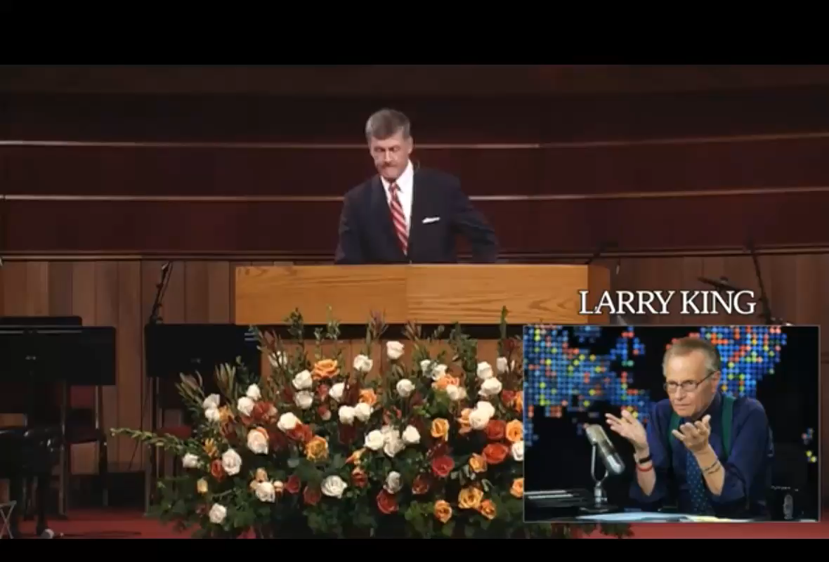
defence of having actual faith in Christ
20

