Slide 1

1
WEEK 10
7-19-26

Slide 2
Ephesians 5:22-25
2
22 Wives, [be subject] to your own husbands, as to the Lord.
23 For the husband is the head of the wife, as Christ also is the head of the church, He Himself [being] the Savior of the body.
24 But as the church is subject to Christ, so also the wives [ought to be] to their husbands in everything.
25 Husbands, love your wives, just as Christ also loved the church and gave Himself up for her,

Slide 3
Ephesians 5:28-31
3
28 So husbands ought also to love their own wives as their own bodies. He who loves his own wife loves himself;
29 for no one ever hated his own flesh, but nourishes and cherishes it, just as Christ also [does] the church,
30 because we are members of His body.
31 FOR THIS REASON A MAN SHALL LEAVE HIS FATHER AND MOTHER AND SHALL BE JOINED TO HIS WIFE, AND THE TWO SHALL BECOME ONE FLESH.

Slide 4
Ephesians 5:32-33
4
32 This mystery is great; but I am speaking with reference to Christ and the church.
33 Nevertheless, each individual among you also is to love his own wife even as himself, and the wife must [see to it] that she respects her husband.

Slide 5

Which is the model?
5
These verses are Paul telling us how we should model a Christian marriage using the church as an example. Paul no where suggests we then reverse that model and have the church look like the marriage, which was modeled after the church.

Slide 6
What is Complementarianism?
6
Complementarianism is a theological belief that men and women are equal in dignity and value but are created with distinct, complementary roles and responsibilities.
The foundational idea of complementarianism is that the genders are "ontologically equal, functionally different". Both sexes are fully in the image of God, but their differences are purposeful and were designed to complete each other.

Slide 7
What is egalitarianism ?
7
In Christianity, egalitarianism is the belief that men and women are created equally in God's image and share equal value, dignity, and spiritual standing. Proponents advocate for equal authority and responsibilities, asserting that the Holy Spirit gifts all believers—regardless of gender—for leadership roles, including teaching and pastoral ministry.

Slide 8
Verses of Complementarianism
8
Complementarianism in practice means a woman can only teach other women and children only.
This comes from:
Ephesians 5
1 Timothy 2
1 Corinthians 14

Slide 9
What is a higher biblical critic?
9
Higher Critics:
Do not consider scripture as “automatic writings” or spiritual dictation by God through the “author”.
Instead, scripture is presented as truth and doctrine inspired by God, yet delivered in the environment of the inspired author.

Slide 10
Women leaders in the new testament
10
Phoebe: Paul commends her in Romans 16:1-2 as a diakonos (deacon/minister) of the church in Cenchreae and a prostatis.
Priscilla (Prisca): Along with her husband Aquila, she led a house church and is credited with instructing the prominent teacher Apollos. She is frequently named first in the scriptures, indicating her primary role in their ministry.
Lydia: A successful businesswoman in Philippi who hosted a church in her home and supported Paul's missionary work.
Philip’s Four Daughters: The Book of Acts notes that all four of these women were recognized prophetesses.

Slide 11
Women leaders in the new testament
11
Phoebe: Paul commends her in Romans 16:1-2 as a diakonos (deacon/minister) of the church in Cenchreae and a prostatis.
Priscilla (Prisca): Along with her husband Aquila, she led a house church and is credited with instructing the prominent teacher Apollos. She is frequently named first in the scriptures, indicating her primary role in their ministry.
Lydia: A successful businesswoman in Philippi who hosted a church in her home and supported Paul's missionary work.
Philip’s Four Daughters: The Book of Acts notes that all four of these women were recognized prophetesses.
◄ 4368. prostatis ►
Strong's Exhaustive Concordance
Assistant
Feminine of a derivative of proistemi; a patroness, i.e. Assistant \
see GREEK proistemi

Slide 12
Women leaders in the new testament
12
Phoebe: Paul commends her in Romans 16:1-2 as a diakonos (deacon/minister) of the church in Cenchreae and a prostatis.
Priscilla (Prisca): Along with her husband Aquila, she led a house church and is credited with instructing the prominent teacher Apollos. She is frequently named first in the scriptures, indicating her primary role in their ministry.
Lydia: A successful businesswoman in Philippi who hosted a church in her home and supported Paul's missionary work.
Philip’s Four Daughters: The Book of Acts notes that all four of these women were recognized prophetesses.
◄ 4368. prostatis ►
Strong's Exhaustive Concordance
Assistant
Feminine of a derivative of proistemi; a patroness, i.e. Assistant \
see GREEK proistemi
◄ 4291. proistemi ►
Lexical Summary
proistemi: To lead, to manage, to rule, to care for
Pronunciation: pro-IS-tay-mee
Phonetic Spelling: (pro-is'-tay-mee)
KJV: maintain, be over, rule
Word Origin: [from G4253 (πρό - before) and G2476 (ἵστημι - standing)]
1. to stand before
2. (in rank) to preside

Slide 13
Women leaders in the new testament
13
Phoebe: Paul commends her in Romans 16:1-2 as a diakonos (deacon/minister) of the church in Cenchreae and a prostatis.
Priscilla (Prisca): Along with her husband Aquila, she led a house church and is credited with instructing the prominent teacher Apollos. She is frequently named first in the scriptures, indicating her primary role in their ministry.
Lydia: A successful businesswoman in Philippi who hosted a church in her home and supported Paul's missionary work.
Philip’s Four Daughters: The Book of Acts notes that all four of these women were recognized prophetesses.

Slide 14
Women leaders in the new testament
14
In Acts 21:8–9, the apostle Paul and his companions arrive in Caesarea and stay at the home of Philip the evangelist (one of the original seven deacons). Luke notes that Philip "had four unmarried daughters who prophesied" (or had the gift of prophecy, depending on the translation).
Historical Significance: Early church writers, such as Eusebius, record that these women were highly celebrated for their prophetical gifts. Their mention in the New Testament is widely viewed as a fulfillment of the Joel 2 prophecy, which stated that God would pour out His Spirit on both men and women in the last days

Slide 15
1 Timothy 2:11-14
15
11 A woman must quietly receive instruction with entire submissiveness.
12 But I do not allow a woman to teach or exercise authority over a man, but to remain quiet.
13 For it was Adam who was first created, [and] then Eve.
14 And [it was] not Adam [who] was deceived, but the woman being deceived, fell into transgression.

Slide 16
1 Timothy 2:11-14
16
11 A woman must quietly receive instruction with entire submissiveness. (Jewish women generally did not receive theological instruction)
12 But I do not allow a woman to teach or exercise authority over a man, but to remain quiet.
13 For it was Adam who was first created, [and] then Eve.
14 And [it was] not Adam [who] was deceived, but the woman being deceived, fell into transgression.
◄ 831. authenteó ►
Lexical Summary
authenteó: To have authority, to exercise authority, to dominate
Part of Speech: Verb
Pronunciation: ow-then-TEH-o
Phonetic Spelling: (ow-then-teh'-o)
KJV: usurp authority over
NASB: exercise authority over
1. to act of oneself
2. (figuratively) dominate

Slide 17
Thesaurus Linguae Graecae
17
The Thesaurus Linguae Graecae (TLG) is a massive digital research database containing virtually all texts written in Greek from antiquity (the time of Homer, 8th century B.C.) to the present era. Based at the University of California, Irvine, and founded in 1972, it is one of the earliest and largest digital humanities projects in the world.

Slide 18
Thesaurus Linguae Graecae
18
Key Features of the TLG Massive Scope: The database contains over 110 million words from more than 10,000 works associated with 4,000 authors.
Historical Range: It spans from Homer through the fall of Byzantium (1453 A.D.) and includes select modern Greek literature.
Included Works: In addition to classical literature, the database covers a wide array of texts, including the Septuagint, the New Testament, and various church fathers and historical documents.

Slide 19
1 Timothy 2:11-14
19
◄ 831. authenteó ►
Meanings for authentein in the TLG between 200 B.C. and 200 A.D. (a 400-year span with the New Testament period at its center) include the following:
– “doer of a massacre”
– “author of crimes”
– “perpetrators of sacrilege”
– “supporter of violent actions”
– “murderer of oneself”
– “sole power”
– “perpetrator of slaughter”
– “murderer”
– “slayer”
– “slayer of oneself”
– “perpetrator of evil”
– “one who murders by his own hand”
11 A woman must quietly receive instruction with entire submissiveness. (Jewish women generally did not receive theological instruction)
12 But I do not allow a woman to teach or exercise authority over a man, but to remain quiet.
13 For it was Adam who was first created, [and] then Eve.
14 And [it was] not Adam [who] was deceived, but the woman being deceived, fell into transgression.

Slide 20
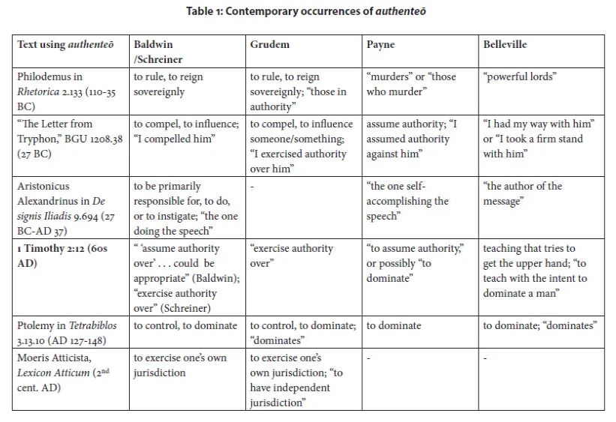
1 Timothy 2:11-14
20
11 A woman must quietly receive instruction with entire submissiveness. (Jewish women generally did not receive theological instruction)
12 But I do not allow a woman to teach or exercise authority over a man, but to remain quiet.
13 For it was Adam who was first created, [and] then Eve.
14 And [it was] not Adam [who] was deceived, but the woman being deceived, fell into transgression.

Slide 21
1 Timothy 2:11-14
21
11 A woman must quietly receive instruction with entire submissiveness.
12 But I do not allow a woman to teach or exercise authority over a man, but to remain quiet.
13 For it was Adam who was first created, [and] then Eve.
14 And [it was] not Adam [who] was deceived, but the woman being deceived, fell into transgression.

Slide 22
1 Timothy 2:11-14
22
In first-century Ephesus, devotees of the Artemis cult believed their goddess was born first and had preeminence over her twin brother, Apollo. Because of this local creation narrative, some followers taught that the female held historical and ontological superiority over the male.
The cult’s mythological timeline claimed the woman came first. In the Ephesian nativity story, the goddess Artemis was born before Apollo, establishing a belief system where the female was the "firstborn" and therefore had dominance.

Slide 23
1 Timothy 2:13-15
23
13 For it was Adam who was first created, [and] then Eve.
14 And [it was] not Adam [who] was deceived, but the woman being deceived, fell into transgression.
15 But [women] will be preserved through the bearing of children if they continue in faith and love and sanctity with self-restraint.

Slide 24
Artimis
24
Midwifery and Childbirth Protectors: Artemis was the primary goddess of midwifery. Because the leading cause of death for women at the time was childbirth, women relied heavily on Artemis for safe delivery and survival. The goddess was associated with painless delivery and protecting women through this perilous passage.

Slide 25
Romans 16:7 NASB 1995
25
7 Greet Andronicus and Junias, my kinsmen and my fellow prisoners, who are outstanding among the apostles, who also were in Christ before me.

Slide 26
Romans 16:7 NASB 1995
26
7 Greet Andronicus and Junias, my kinsmen and my fellow prisoners, who are outstanding among the apostles, who also were in Christ before me.
Romans 16:7 NASB 2010
7 Greet Andronicus and [e] Junia, my kinsfolk and my fellow prisoners,

Slide 27
Romans 16:7 NASB 1995
27
The name Junia appears as a female Latin name over 250 times in Greco-Roman records and inscriptions from the first century.
For over 1,000 years, the early church universally recognized Junia as a female name. However, starting in the Middle Ages, some translators began rendering it as the masculine "Junias". Historical and philological research has revealed that the masculine name "Junias" (or "Junianus") appears exactly zero times in first-century historical records, papyri, or inscriptions.

Slide 28
Romans 16:7 NASB 1995
28
7 Greet Andronicus and Junias, my kinsmen and my fellow prisoners, who are outstanding among the apostles, who also were in Christ before me. (1977 as well)
Romans 16:7 NASB 2010
7 Greet Andronicus and [e] Junia, my kinsfolk and my fellow prisoners, who are outstanding

Slide 29
Romans 16:7 NASB 1995
29
7 Greet Andronicus and Junias, my kinsmen and my fellow prisoners, who are outstanding among the apostles, who also were in Christ before me. (1977 as well)
Romans 16:7 NASB 2010
7 Greet Andronicus and [e] Junia, my kinsfolk and my fellow prisoners, who are outstanding in the view of the apostles, who also were in Christ before me.

Slide 30
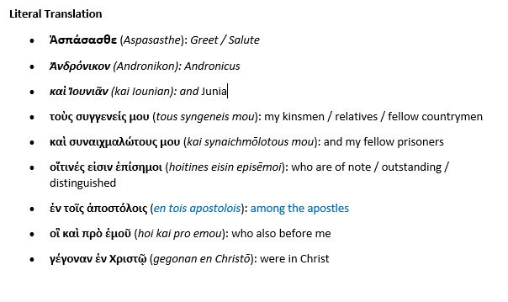
Romans 16:7
30

Slide 31
Romans 16:7
31
How it means "among“
When tois is combined with a plural noun and a preposition like "en" (ἐν, meaning "in"), it often gets translated into English as "among.
Example: The phrase en tois apostolois (ἐν τοῖς ἀποστόλοις) literally means "in the apostles". However, in English, we idiomatically translate this as "among the apostles."

Slide 32
Romans 16:7
32
John Chrysostom, a prominent 4th-century Church Father and native Koine Greek speaker, undeniably affirmed that the biblical figure Junia (mentioned in Romans 16:7) was both a woman and an outstanding apostle. In his Homilies on Romans (specifically Homily 31), Chrysostom famously marveled at her high standing and dedication to the faith, praising her spiritual greatness

Slide 33
Arch Bishop john chrysostom
33
Her Status as an Apostle: Regarding the phrase "outstanding among the apostles" (Romans 16:7), Chrysostom noted: "To be an apostle is something great. But to be outstanding among the apostles—just think what a wonderful song of praise that is!"

Slide 34

Nefarious on tubi tv
33

